Slide 1
Amplification is the primary mode of gene-by-sex interaction in complex human traits
Carrie Zhu & Arbel Harpak
2/9/2022

Slide 2

Motivation
Males and females have different characteristics, disease risk, etc
Vast majority of genetic effects come from autosomes
GxE for complex traits; polygenic nature
For humans, sex is a good place to start
Make use of UKBB data
300k individuals, White British ancestry
Notes:
Sexual dimorphism, males and females have differences in complex traits and disease risk; important later for treatment and future research
Contributed by differences in genetic architecture. Many think sex chromosomes, but effects are largely concentrated in autosomes. Autosomes explain most of the heritability, and is relatively the same between males and females.
Originally wanted to study GxE for complex traits in humans. With other species, you can do things like control the environment, which can help develop the methodology. Not with humans.
In humans, GxE is hard to define and research is often underwhelming.
So with humans, we decided to use sex as our environment, typically a binary difference – male or female – and within the UKBB, there is not heavy recruitment bias.
Sex minimizes bias from population structure, reverse causality (phenotype doesn’t affect sex).
Furthermore, sex is independent from the genotype frequency due to random segregation, which helps us look at the environment side.
Possibly help us look for other types of GxE in humans.

Slide 3
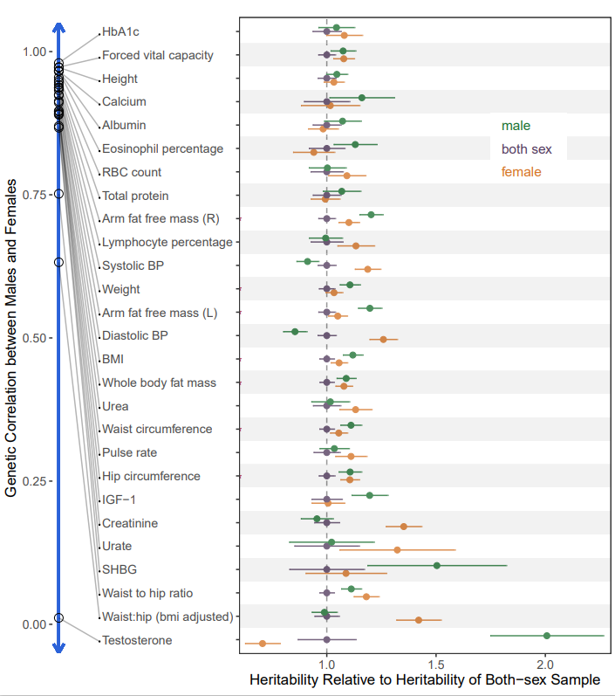
Previous Studies
Sex-specific SNPs
Genetic correlation
Heritability differences
Notes:
Previous studies of GxSex focus either on specific SNPs of biological importance or general calculation of correlation and heritability differences between the sexes.
Sex-specific SNPS: test for associations, interaction level of individual SNPs. Many studies find sex-specific SNPs and go into the biology of it to see how it affect males v females.
Due to polygenic nature of traits, results have been underwhelming, and don’t often find big effects. Testosterone, sex hormone, is one exception.
Switch over to think about it in a more polygenic way.
Looked at genetic correlation and heritability differences. Heritability described as the fraction of phenotypic variance explained by all the SNPs, or genetic effect. Correlation how the effect sizes between males and females correlate with each other. Most high, above 0.9.
We see that male or female specific heritabilities are both higher than both sex. Possible evidence of different directions of effect, dilute the heritability. Heritability difference also tends to increase with decreasing correlation. But not consistent trend which can point to amplitude differences rather than opposite sign. Either way, proves that the numbers don’t tell the full story, lot of it is just conjecture
Gives a nice overview, but also doesn’t tell the full story. We can give general explanations, but we hoped to find something more concrete.

Slide 4
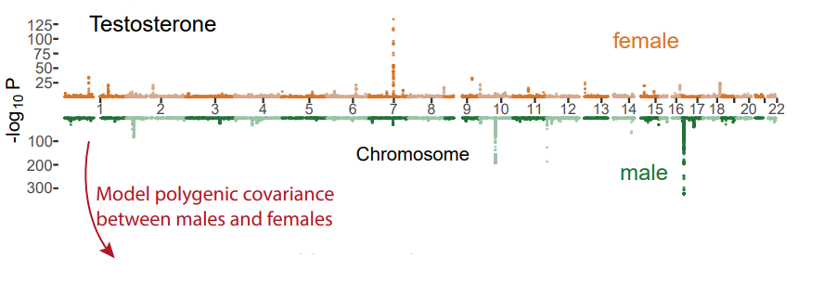
Infer Polygenic Covariance Structure
Method
Obtain sex-specific GWAS effect and standard error estimates
Input hypothesis covariance matrices into mash
Magnitude of amplification and correlation hypothesis
mash calculates posterior weights for each covariance matrices
Notes:
Therefore, we looked to examine the covariance structure between males and females, which will give us more information about the correlation and amplification of effect sizes.
So rather than looking at specific SNPs, we are looking at genetic architecture more wholistically. Past heritability and correlation, we are seeing how effect sizes are distributed with each trait.
Mash provides mixture weights on inputed covariance matrices, signifying the proportion of effects (SNPs) that correspond to that matrix. Learns patterns in the data.
Input matrix of male and female GWAS effect size and standard error estimates., our summary data. Then we listed hypothesis covariance matrices for mash to learn from, which span a range of interpretations.
Mash can also compute data driven matrices, which basically is where mash is learning from the strongest signals to create a covariance matrice matching the patterns it sees. But we decided to remove it since the data driven matrices it produced was essentially the same as some of our hypothesis matrices.
So for all the hypothesis matrices, mash calculates a weight, representing proportion of SNPs that correspond and we use those weights to examine the architecture and use it for future analysis.

Slide 5
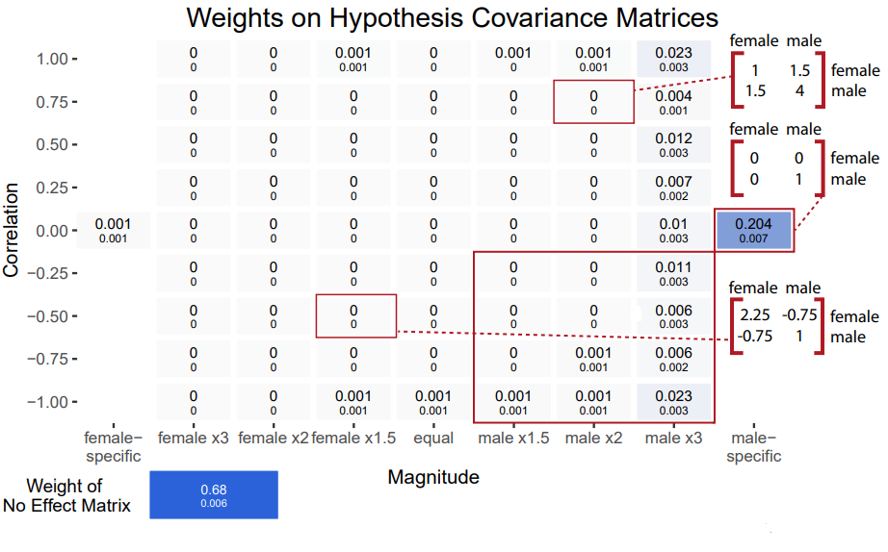
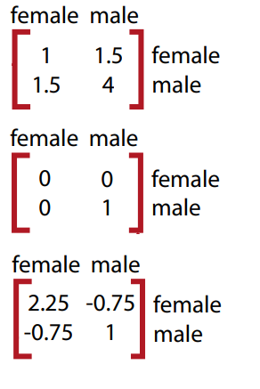
Testosterone
Notes:
Covariance matrix example: diagonals are variance and covariance between males and females. 1st example, x2 male amplification than female, correlation of 0.75.
We create multiple hypothesis matrices that represent different levels of interpretation. Range from -1 to 1 correlation and x9 female or male amplification. Or female and male specific effects.
Inputted these into mash, mash calculated weights on each matrix and we produce this plot with each box representing a matrix. We can see that for testosterone, almost all of the non-null (effect) weight is on the male-specific matrix. Confirms testosterone as a male sex hormone and previous studies.

Slide 6
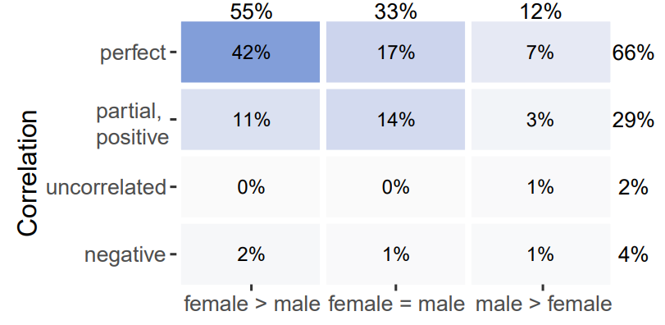
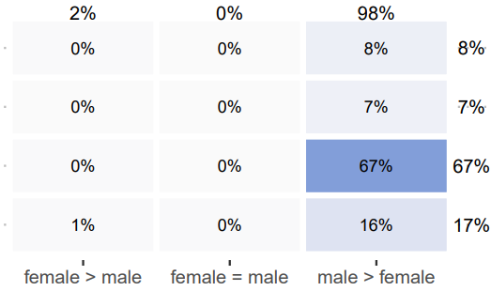
Covariance of Genetic Effects Compact Representation
Diastolic Blood Pressure
Testosterone
Magnitude
Notes:
We condense the previous plot, to show just different levels of correlation, and female greater than, male greater or equal magnitude of effect sizes.
On right is testosterone, we see better that most weight is on male > female effect magnitude and uncorrelated effects.
On left, diastolic BP is concentrated on perfect correlation of effect sizes between males and females, but the amplification is significantly higher in females than males.
Gives a better picture than simple heritability or correlation. We see a lot of high correlation, but the amplitude is different between the sexes.

Slide 7
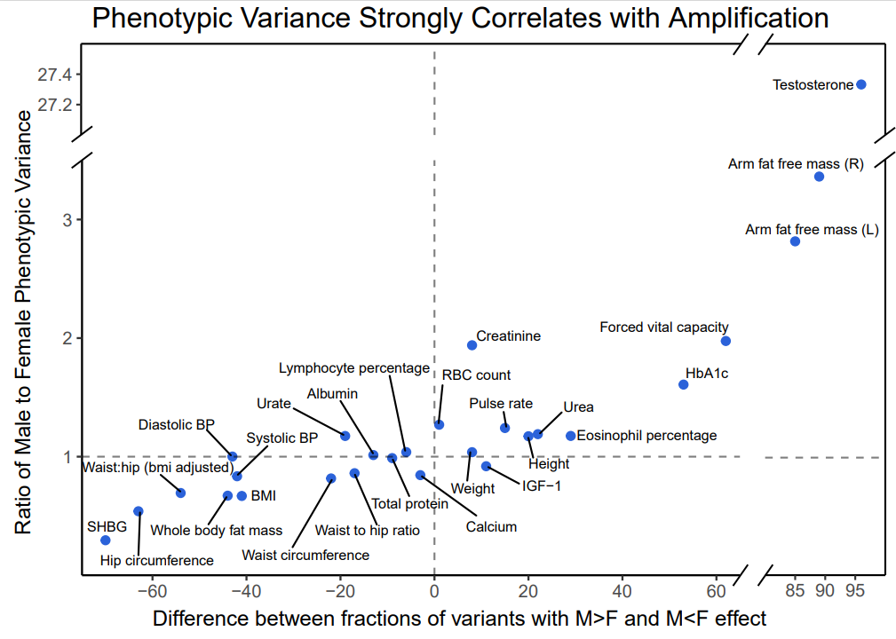
Notes:
So is amplification the primary driver of GxSex interactions?
X-axis : difference between weight with M>F and F<M effect (sums from last slide)
Y-axis : calc pheno var for males and females and took the ratio of them
Amplification – see that phenotypic variance ratio strongly correlates with it. Amplification is explaining or contributing to differences between male/female phenotype.

Slide 8
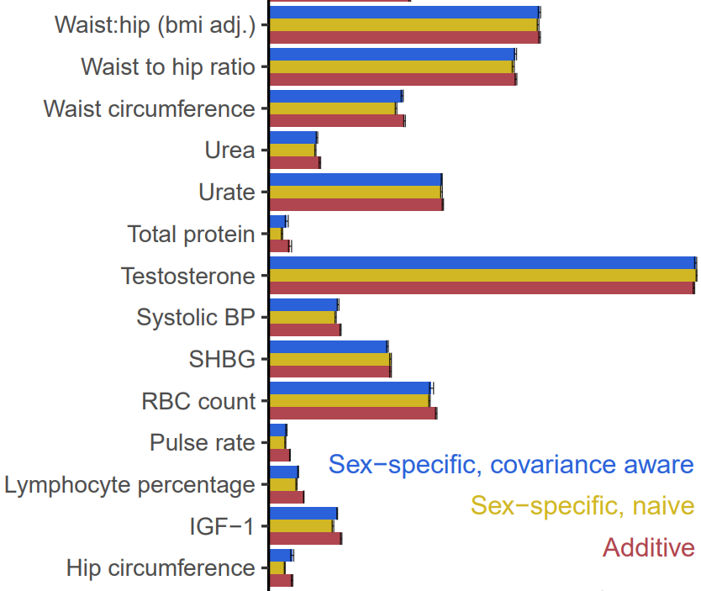
Comparing PGS
Method
Sample 25k out of ~150k male and females for test set
additive; sex-specific additive; and sex-specific covariance aware (mash)
Clump and PGS
Conduct over 5 folds
Combined model: use sex-specific scores to predict phenotype for corresponding sex
Sex-specific covariance aware model does not show significant improvement against the additive model
Notes:
With magnitudes of effect sizes explaining phenotypic variance, if we utilize estimates based on weights on covariance matrices from mash, can we predict phenotypes better?
Mash provides better estimates by taking into consideration the covariance structure, amount of null signals, applies shrinkage and weights.
Using these improved effect estimates, we compare with simple naïve GWAS results.
PGS summarizes the effect of genetic variants on a phenotype.
Separated sample by sex, took 25k of each sex. Did GWAS with combined sex, sex-specific. Mash on sex-specific GWAS. Calculated PGS for each model.
For prediction, the additive combined sex is your typical one using it to predict phenotype and obtaining the R^2.
For sex-specific, we used the sex-specific scores to predict the phenotype for the corresponding sex.
However, sex-specific covariance aware model did not predict better than the additive model. Showed that the advantage of using a sample 2x the size was still more beneficial than using better estimates, but half the size.
Therefore, covariance aware did not give a sig advantage in prediction than simple additive, combined model.

Slide 9
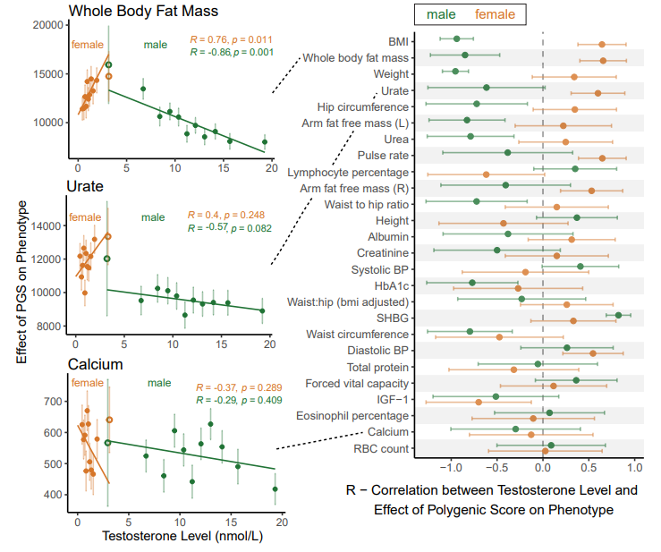
Testosterone as an underlier
Method: Regress phenotype value on PGS over multiple testosterone bins
Hollow circle signify overlapping bin
Equal testosterone level in males and females
See significant relationship with testosterone levels for many body mass related phenotypes
Clear, but often contrasting relationship between males and females
Notes:
We then thought about explanations for these differences in genetic effect that we were seeing.
Previous research into testosterone, as a sex hormone, affect many processes differently in males and females. Distinct pathways between the sex. Could it be an underlier to the differences in effect?
Measure of genetic effect: regress phenotype value to PGS for multiple testosterone bins. Y axis the slope, how phenotype value increase with score.
For body mass related traits, the direction of correlation was opposite. Supports previous research in women, BMI and testosterone are positively correlation, while in men, negatively. More free testosterone in obese women, less free testosterone in obese men.
Further research in studying estrogen as another sex hormone.

Slide 10
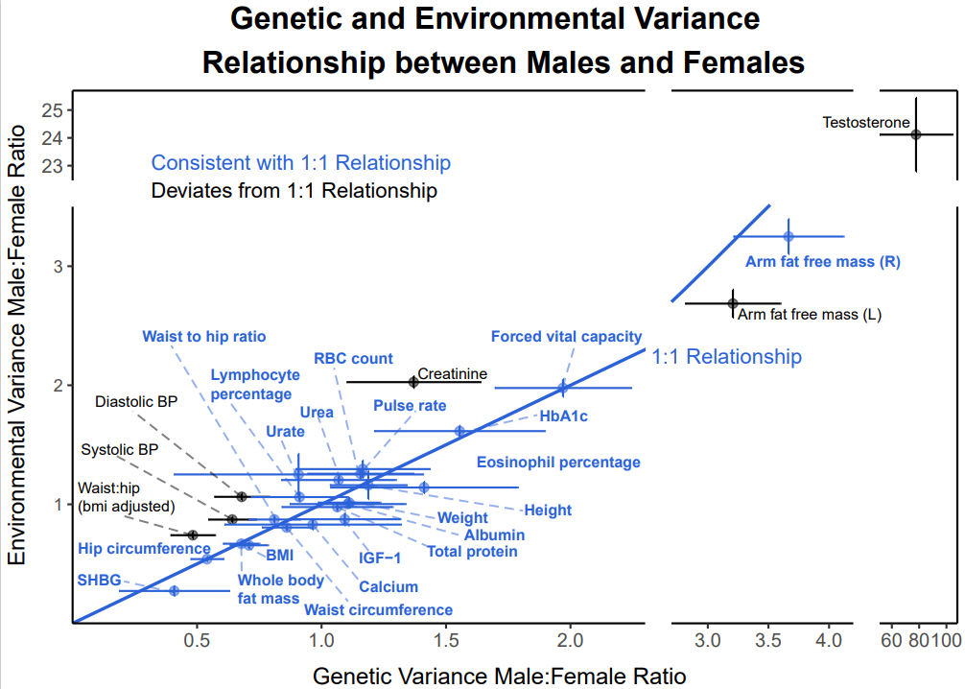





Amplification of Genetic and Environmental Variance
Phenotype depends on effect size and genotype
genotype largely independent from sex
Is amplification of genetic variance same for environmental variance
$$G_{f}$$
$$×α$$
(amplification)
$$Y_{f}$$
$$Y_{m}$$
$$E_{f}$$
Notes:
Saw amplification in genetic effect between males and females. See if the same effect is present in the environment.
Phenotype depends of effect size and genotype frequency. Determined sex is independent of genotype frequency due to random segregation, among less recruitment bias. Therefore, we can assume amplification of genetic effect is driving phenotype differences. However, is environmental effect also random between males and females.
Genetic variance = heritability x phenotypic variance
Environmental variance = (1 – heritability) * phenotypic variance
Error bars represent 4 SE. Most fall on or near line of 1:1 equal relationship.

Slide 11
Appendix A – mash Pipeline
Male and female specific GWAS effect sizes and SE
Random subset, select SNP from each LD block (1703)
Fit mash model, obtain mixture weights
Repeat 100x, obtain average weight and SE
mash
Input hypothesis matrices, remove data-driven covariance matrices

Slide 12
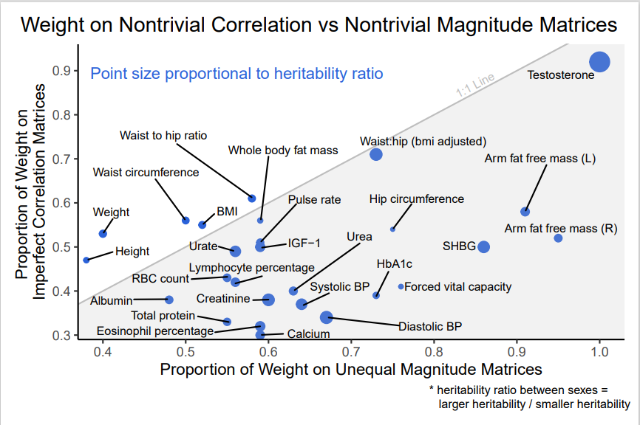
Appendix B mash nontrivial weights

Slide 13
Appendix C – PGS Pipeline part 1
Sample Set
Sample IDs
Random sample 25k male, 25k female
Test sample IDs
Models
Additive both-sex
Additive male-specific
Additive female-specific
Mash male
Mash female
PGS
P-value thresholds: 1, 0.01, 1e-5, 1e-8
Training Set
GWAS
Both-Sex
Clump
Remove SNPs with R^2 higher than 0.1 or within 250kb of index SNP
4 thresholds * 5 models = 20 PGS
Remove test sample, then conduct GWAS
GWAS
Male-specific
Mash posteriors:
Convert lfsr to pseudo-p-values by matching order with GWAS p-values
GWAS
Female-specific
Mash mixture proportions (100x)

Slide 14
Appendix C – PGS Pipeline part 2
Null Model
Phenotype ~ covariates
Phenotype + Covariate file
Keep only test IDs
Obtain R^2
Incremental R^2 = R^2 – null R^2
PGS Model
Phenotype ~ covariates + PGS
Additive
Sex-specific, naïve
Sex-specific, covariance aware

Slide 15


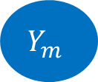

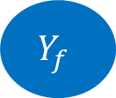
Appendix D—Amplification of Genetic and Environmental Variance Model
Female
Male
$$G_{f}$$
$$×α$$
(amplification)
$$Y_{f}$$
$$Y_{m}$$
$$E_{f}$$

Slide 16
Appendix E—Amplification of Genetic and Environmental Variance Model pt 2
Genetic Regulation
Core gene affecting BMI
Effect size of core gene
BMI
Maternal epigenetic affect on fetus
Modulates
Testosterone Level

